Slide 1
Confucianism
Beliefs (not a religion) based on the teachings of Kong Fu Zi.
Practical philosophy for life and government.
Proper Conduct
Respect for Elders
Education
Government Service

Slide 2
Code of Behavior Revolved Around Five Relationships:
Ruler & Subject
Parent & Child
Husband & Wife
Sibling & Sibling
Friend & Friend
These relationships should be harmonious.

Slide 3
Daoism
Religion based on the teachings of Laozi (first Daoist philosopher)
Goal of life was to achieve oneness with the Dao (universal force – cannot be defined, only felt)
Humans are part of nature and should understand that change is a part of everything

Slide 4
People should live simply, in harmony with nature
The Dao guides all things
Daoists do not believe in a strong government
Happiness and peace can be achieved by contemplating nature and leading a balanced life (yin and the yang)

Slide 5
Buddhism
Religion based on the life and teachings of Siddhartha Gautama (Buddha)
Buddhism was brought to China from India by Buddhist monks.

Slide 6
Four Noble Truths
All life is suffering and pain
Suffering and pain are caused by desire for wealth, pleasure, fame, and power
To end suffering, one must overcome desire
To overcome desire, one must follow the Middle Way.

Slide 7
The Middle Way
Stresses virtuous conduct and compassion for all things
Reincarnation (soul is reborn in a new body)
Attain Nirvana (the condition of desiring nothing)
When Nirvana is attained, he or she breaks the cycle of life and death and is no longer reincarnated.
Final goal is to bring enlightenment to others

Slide 9
Buddha

Slide 11
Confucius

Slide 13
Laozi

Slide 15
Buddha

Slide 16
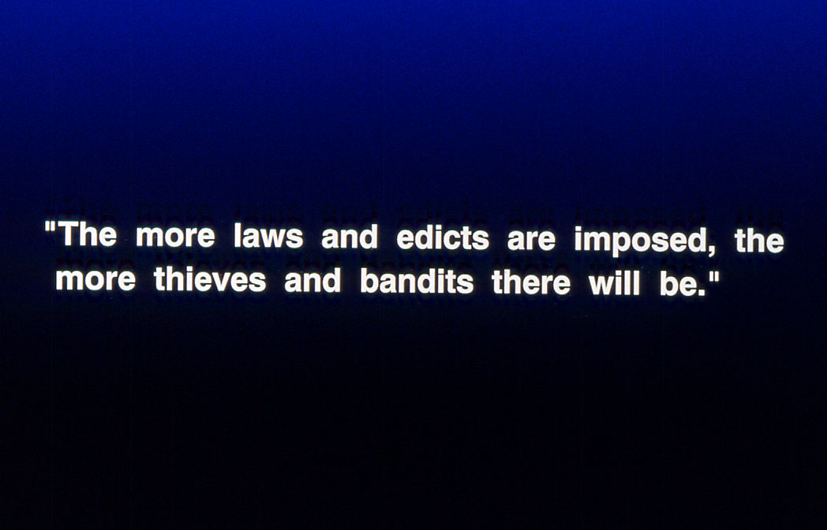

Slide 17
Laozi

Slide 19
Confucius

Slide 21
Confucius

Slide 23
Laozi

Slide 24
“Life is a journey, death is a return to the earth, the universe is like an inn, the passing years are like dust.”

Slide 25
Buddha

