Slide 1
Japan Under the Shoguns
Key Terms/People: bushido, armada, typhoon, Oda Nobunaga, Toytomi Hideyoshi, Tokugawa Ieyasu

Slide 2
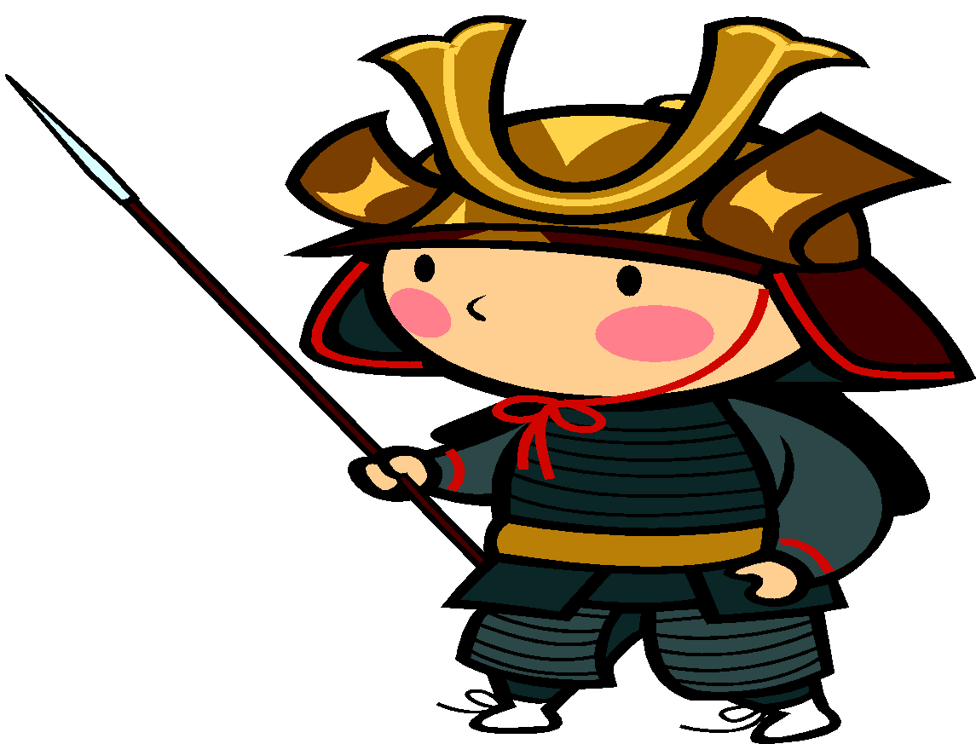
The Way of the Warrior
Honor & Loyalty
Bushido: Strict code of conduct that guided the behavior of samurai.
I will live or die with a sword in my hand!

Slide 3
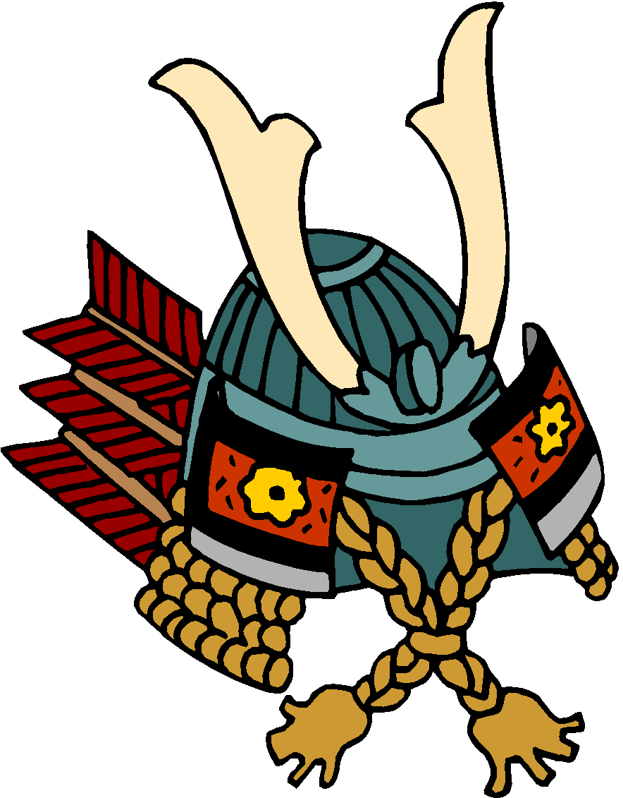
Under the Bushido Code
Loyalty to one’s lord is more important than family.
If a lord was in danger, a samurai would follow him.
Personal honor highly important.

Slide 4
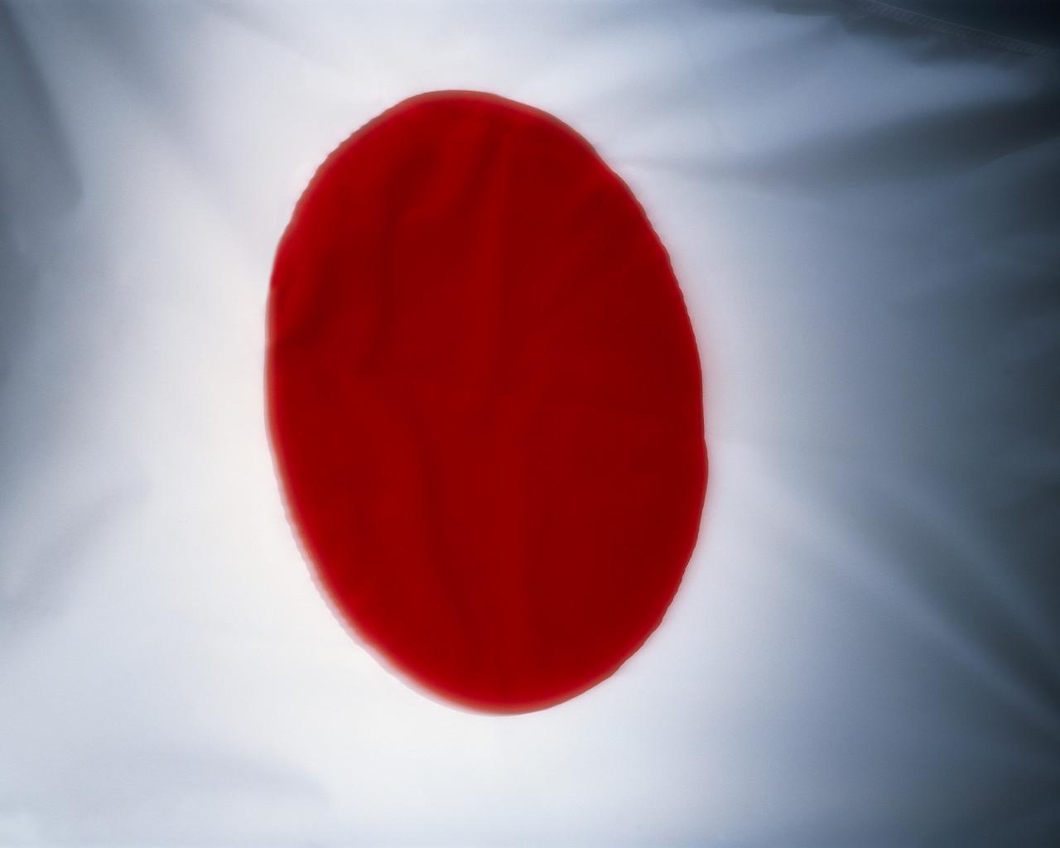
Mongol Invasions…
They took over China in the 1200’s
Kublai Khan soon ruled all of East Asia
1268, Kublai sent officials to Japan demanding tribute.
The shogun’s government sent the representatives away.
Kublai was angered and decided to...
…INVADE JAPAN

Slide 5
The First Invasion…
First Invasion
Nov. 1274: Kublai sent an armada of ships, carrying more than 25,000 Mongol and Korean troops.
Horses, weapons, and bombs!
The samurai fought bravely and held off the invaders.
The Mongols returned to Sea despite warnings and a fierce storm killed nearly 13,000 men. This didn’t stop the great Khan…

Slide 6
Khan sent more officials to Japan demanding tribute. This time…the shogun had them beheaded!

Slide 7
The Second Invasion…
1281, Kublai Khan tried again.
Sent 140,000 soldiers.
Japanese Warriors held off the attack and prayed to the gods for help.

Slide 8
Without warning, a typhoon battered the Mongol ships, and towering waves drove them against the shore. Thousands were drowned, those left…the Japanese killed.

Slide 9
Japan is Unified Again
The end of the Mongol threat did not bring peace.
With no outside enemy to unite them, the clans continued to fight amongst themselves.
More than two centuries would pass before Japan would be unified again.
This period of time is called, “The Age of the Country at War.”

Slide 10
Weak Emperors
As violence spread, respect for the emperor declined. So did tax revenues.

Slide 11
Three Strong Leaders…
Oda Nobunaga – worked all his life to bring Japan “under a single sword.”
Toyotomi Hideyoshi – unified Japan in 1590. Unification only succeeded because of loyalty to him, when he died…clans fought again.
Tokugawa Ieyasu – took the title of Shogun.
Founded a new capital in Edo.
Ordered Daimyo to destroy castles and move to Edo.
Under Tokugawa, Japan was unified at last (at least until 1868).

Slide 12
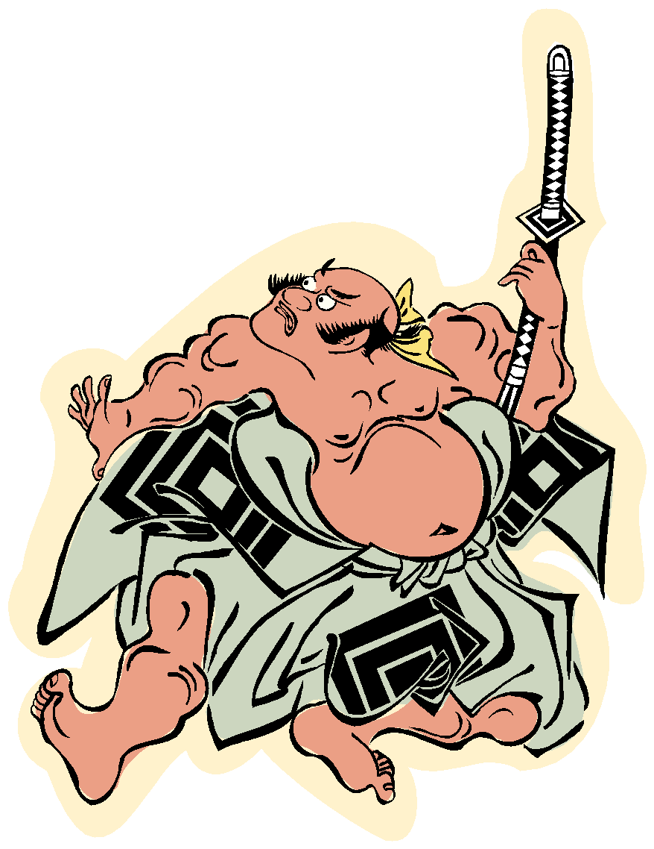
The Changing Samurai World…
Once Japan was at peace, the samurai way of life changed. Many took government jobs.
In 1876, laws prohibited samurai from carrying swords. Their way of life was over.

Slide 13
Japan today…
The ideals of bushido (bravery and loyalty) continue to influence Japan.
Comic books, cartoons, and video games celebrate the “way of the warrior.”
It also lives on in…

Slide 14
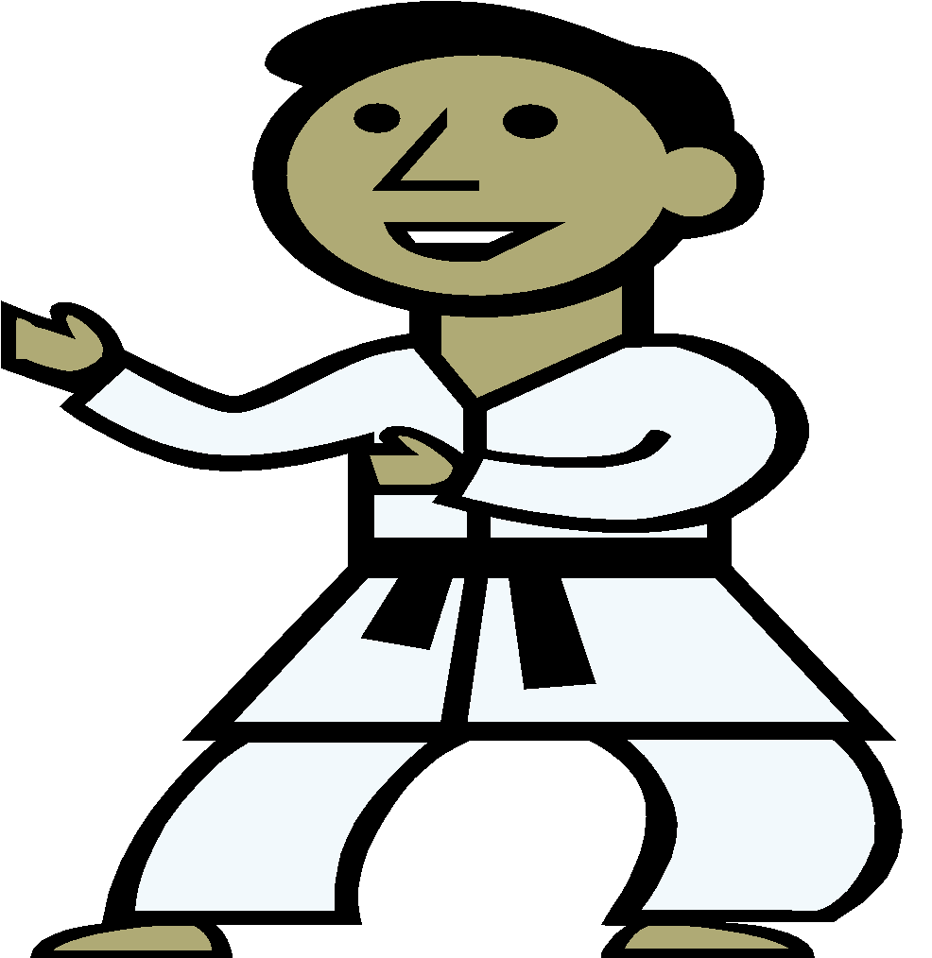
KENDO (Japanese school of martial arts)
Kendo means,
“the way of the sword.”

